Slide 1

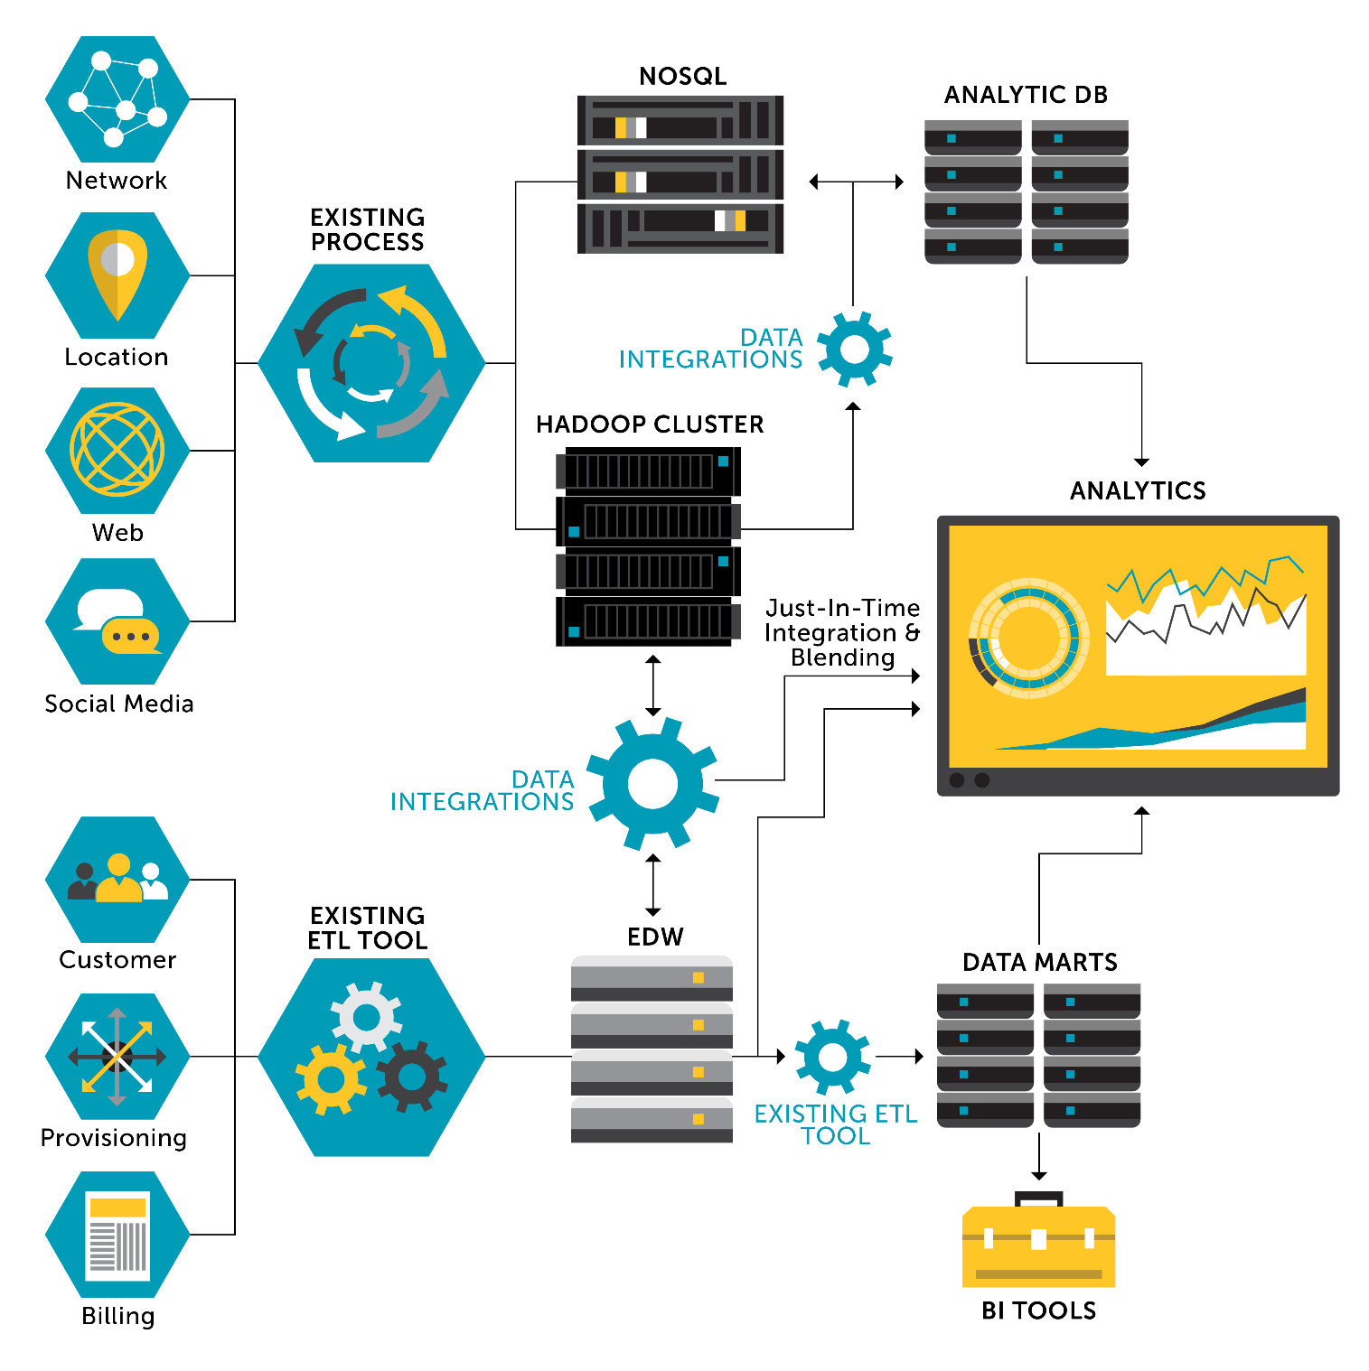

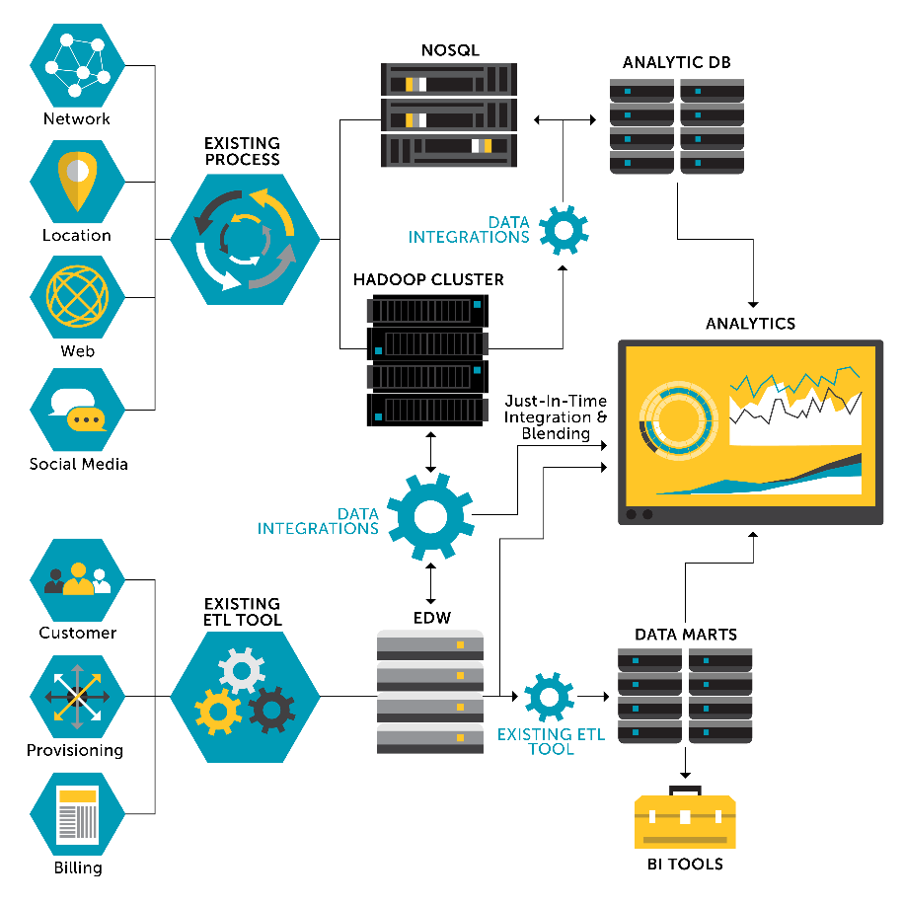

Servier
Patrimony
targets, projects, clinical trials
Integrated Data & Knowledge-bases
Drug Targets
3D Assessment
Hypotheses
Generation
Hypotheses
Consolidation
Hypotheses
Validation
Therapeutic Area
from CTI research & translational activities
access, curation, integration
systems
analytics
biological relevance
druggability
ranking, priorities
systems biology &
legacy ranking
experimental In vitro and In vivo
Public
Datasets
external resources
free to use or not

Slide 3
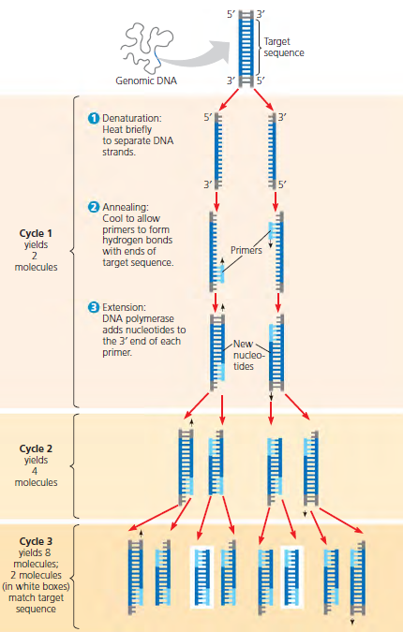
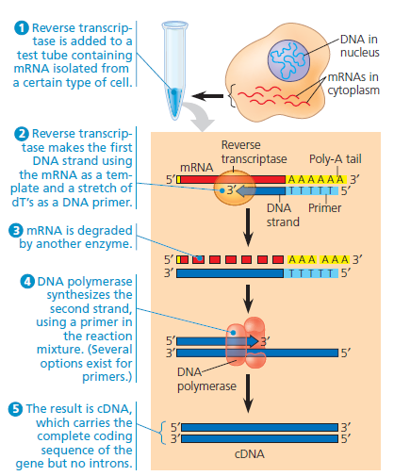
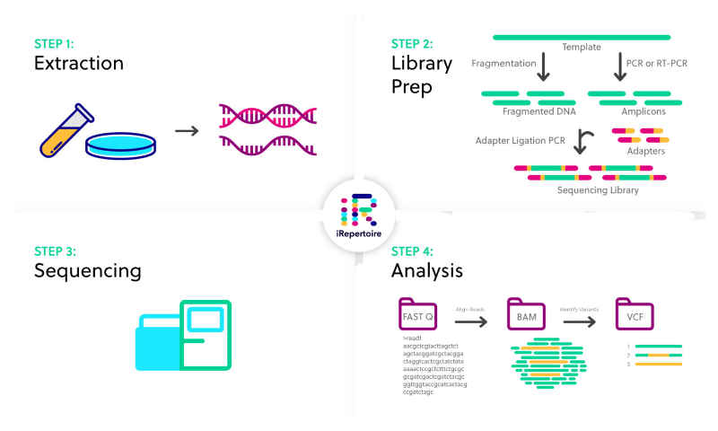
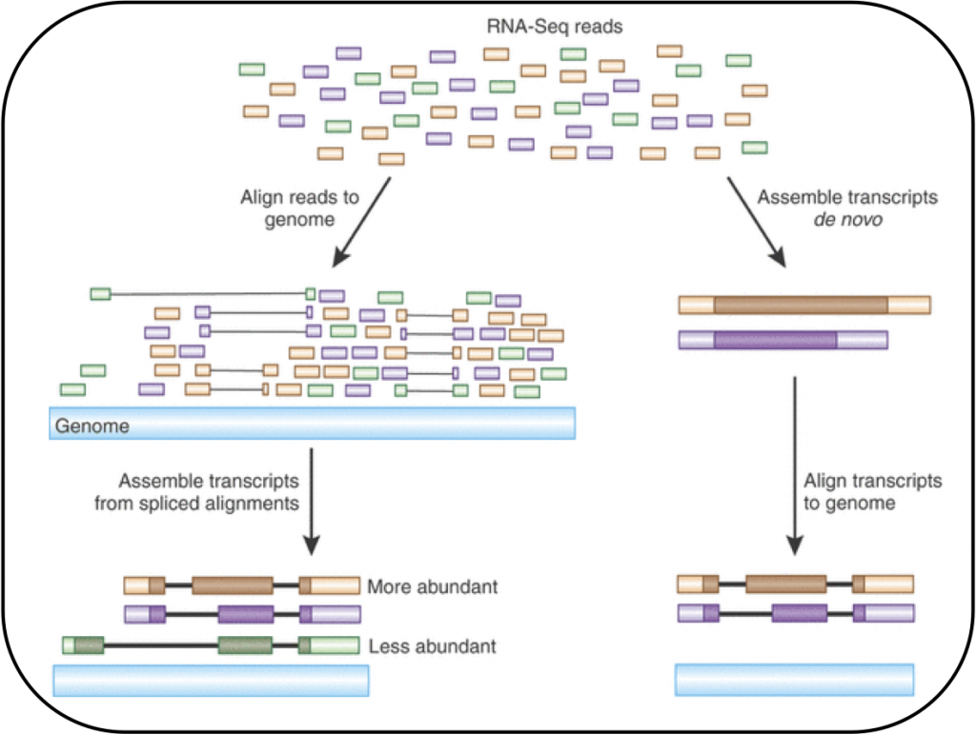
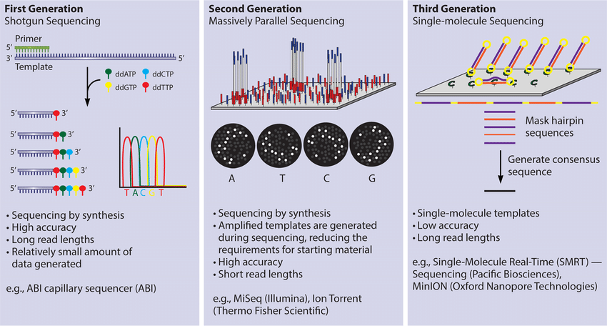
a) extraction
b) amplification
c) sequencing
d) alignment

Slide 4
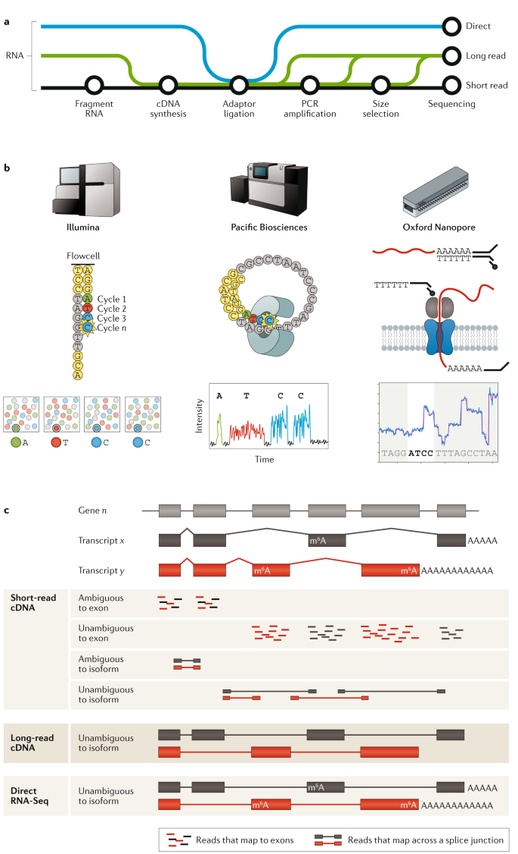
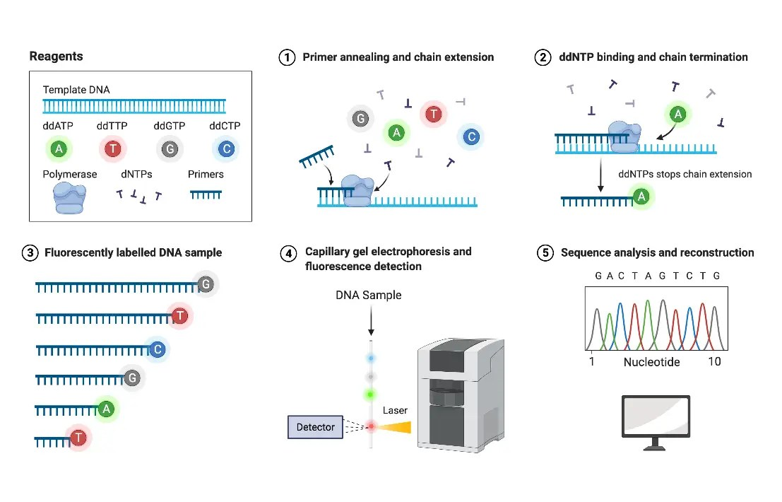
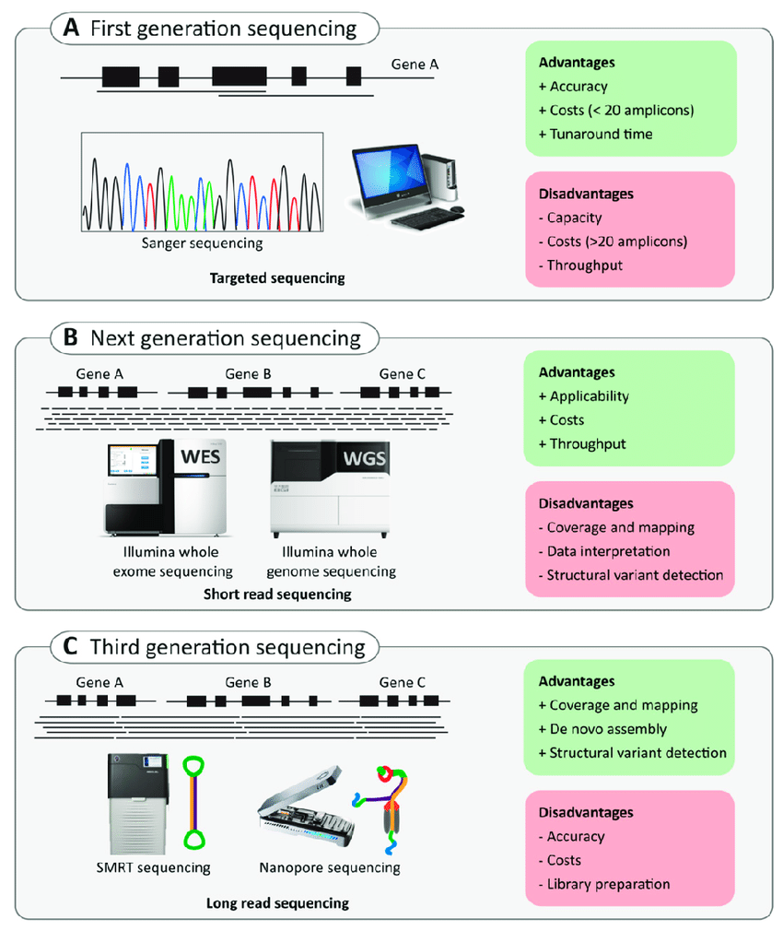
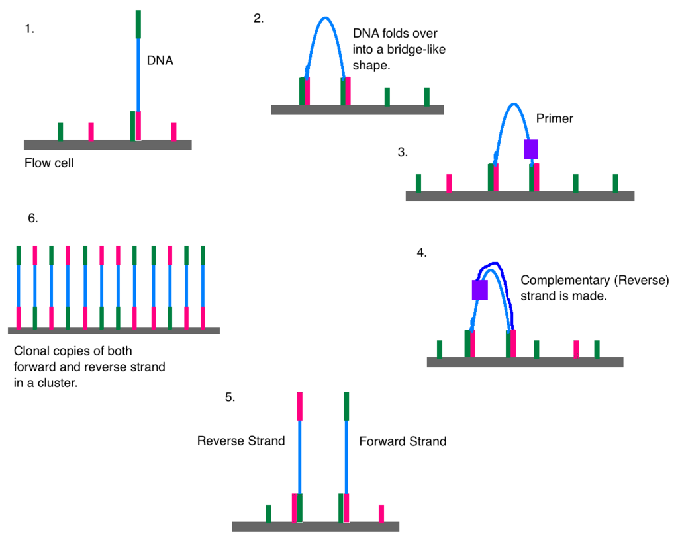
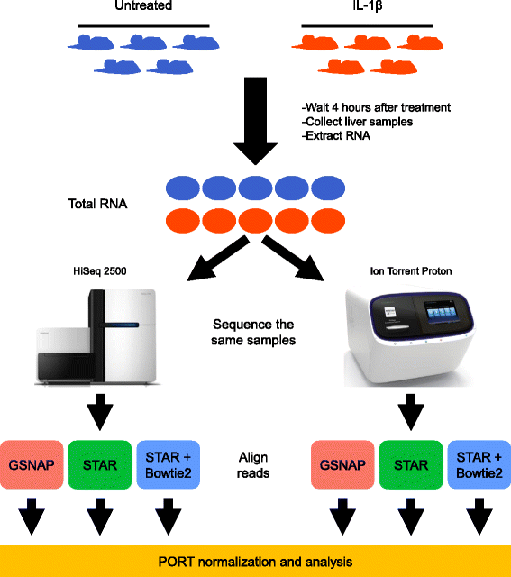
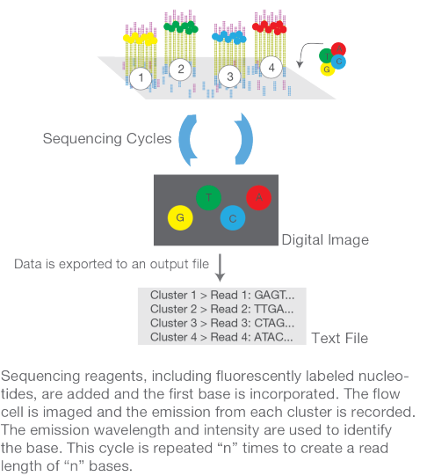
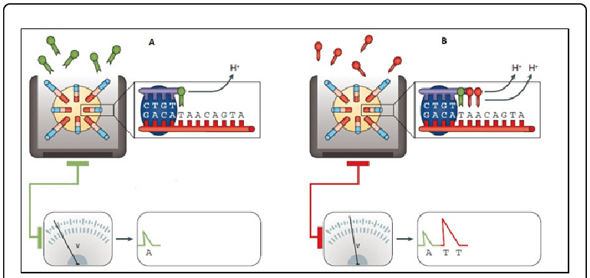
c) third-generation
a) Sanger sequencing
Cluster amplification
b) second-generation
Sequencing

Slide 5
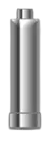
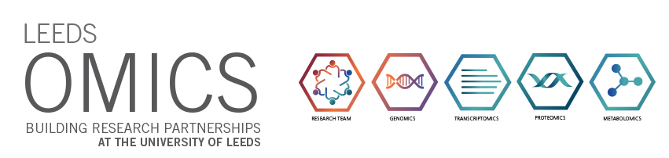
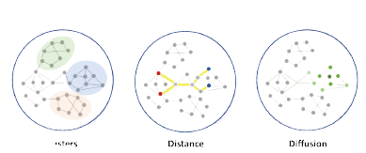
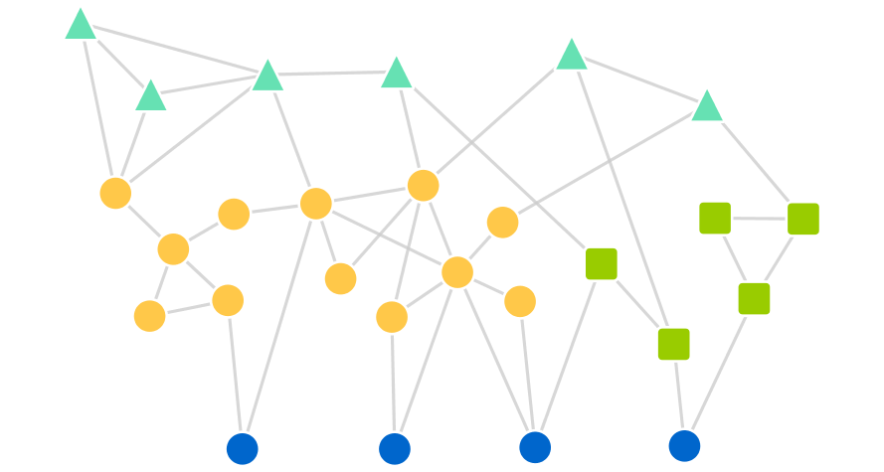


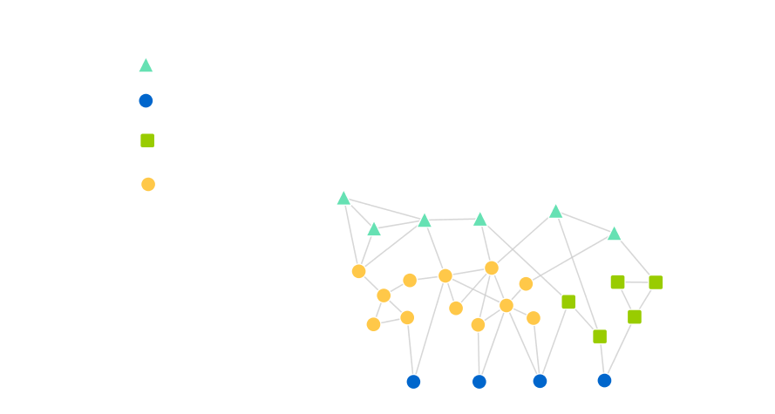
PATHWAY IDENTIFICATION
C) DYSREGULATED PATHWAYS
A) DATA
INTEGRATION
B) COMPUTATIONAL
MODELING
D) CANDIDATE /
REPURPOSING TARGETS
DISEASE
distance
diffusion
Knowledge graph
clusters
13 373 drugs
Public Databases
Pharmacological space
Target prioritisation
SIDER
Clinical
space
Biomolecular
space
Disease space
Drugs
Diseases
Genes
Proteins
Clinical effects
Adverse Events
> 150 databases in the drug repositioning literature
Network of
23 781 genes / proteins
2 335 diseases
18 650 drugs
8 951 diseases
318 025 studies
213 858 interactions

Slide 6
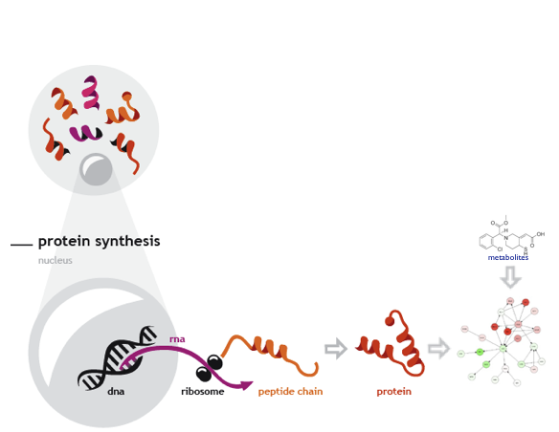
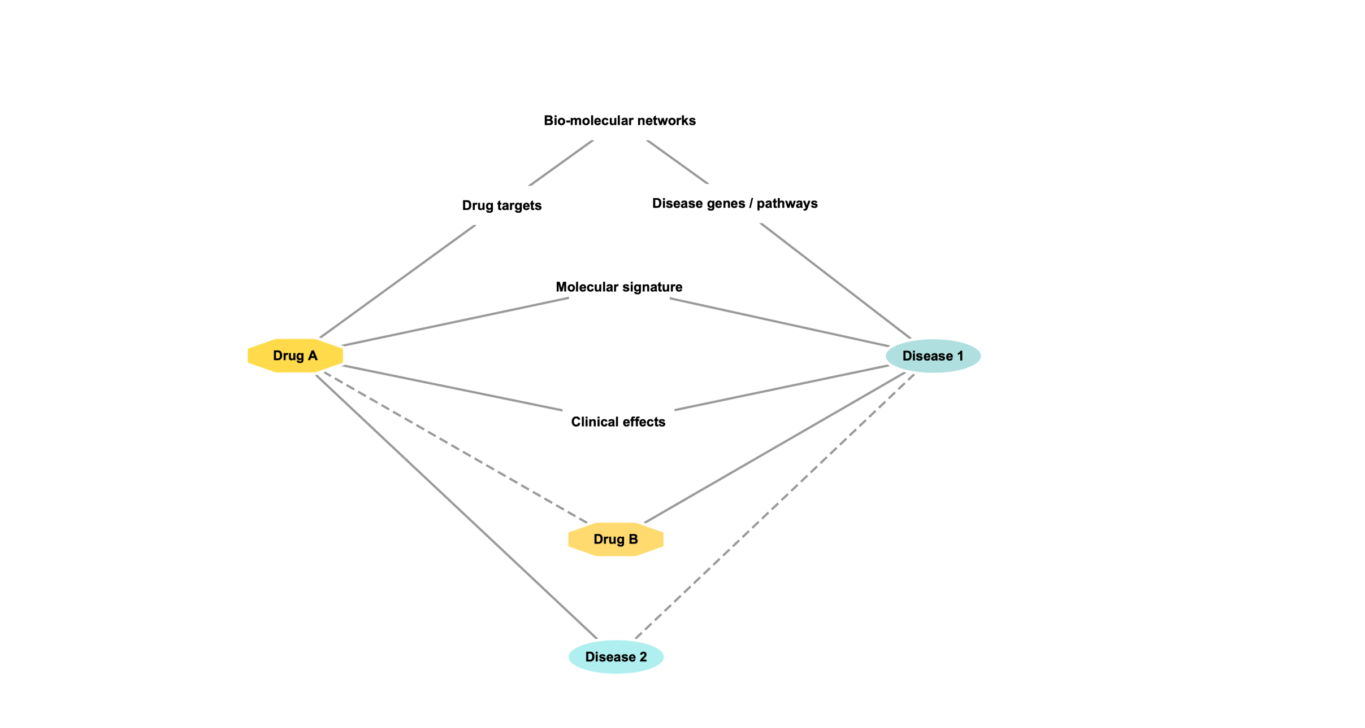
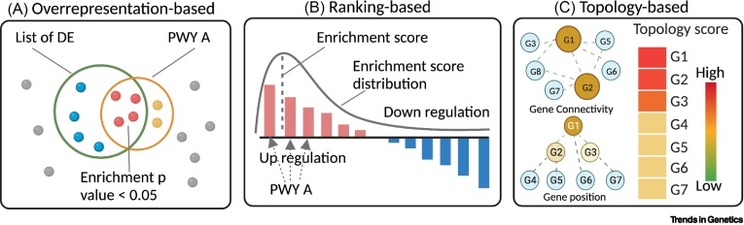
CELL
PPI databases
metabolites
Biomolecular
networks
DTI database
GEO or ArrayExpress
⇨
⇨
⇨
perturbation
Cmap or L1000
dysregulated expression
Guilt-by associations
SIDER
guilt-by-association
Signature profiles

Slide 7
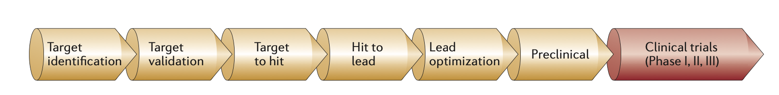
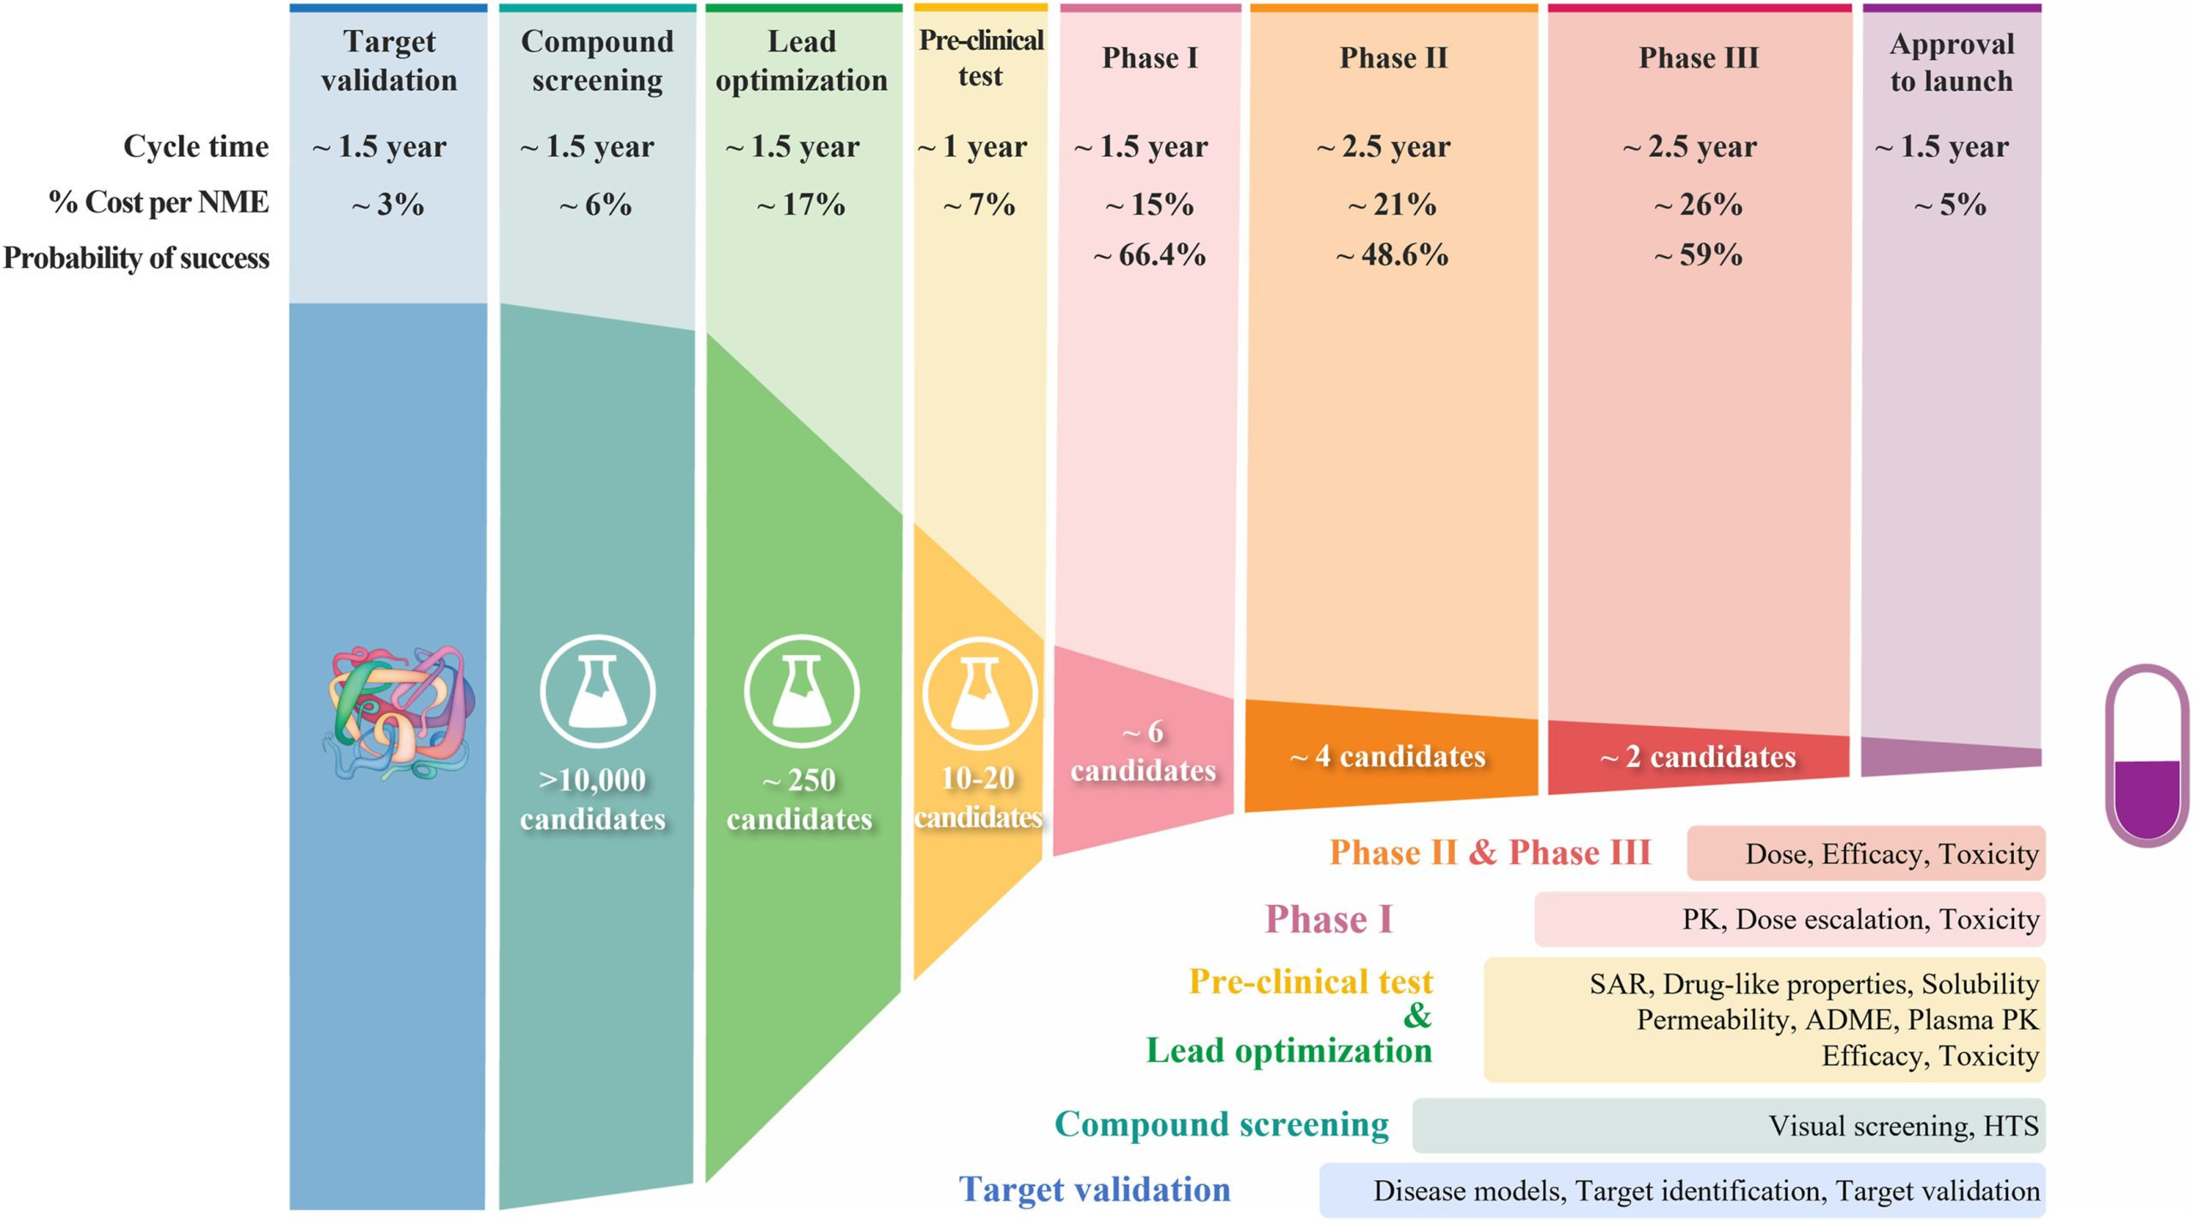
Computational repositioning

Slide 8
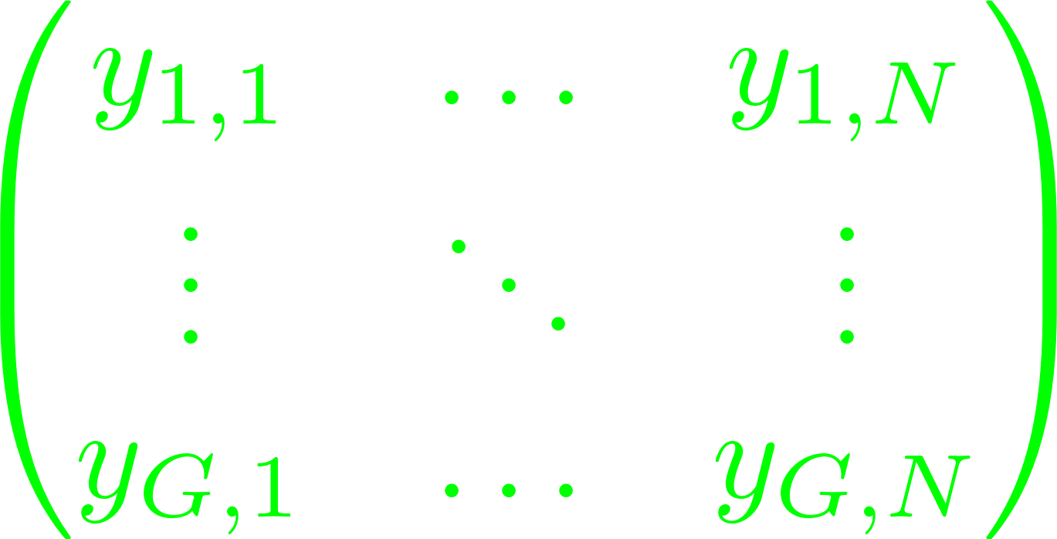
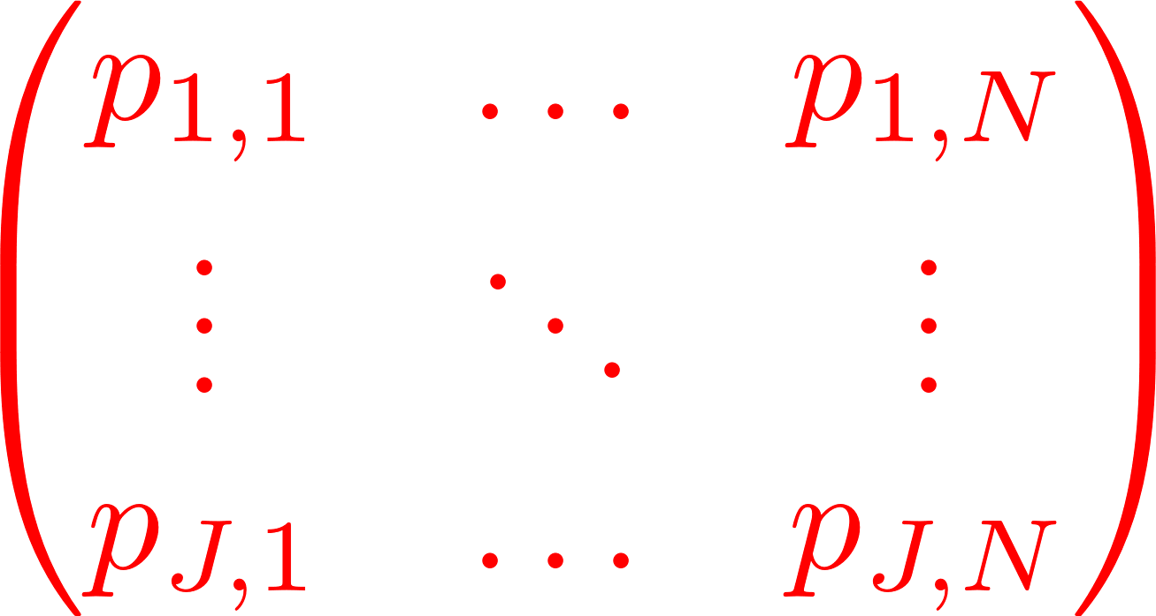
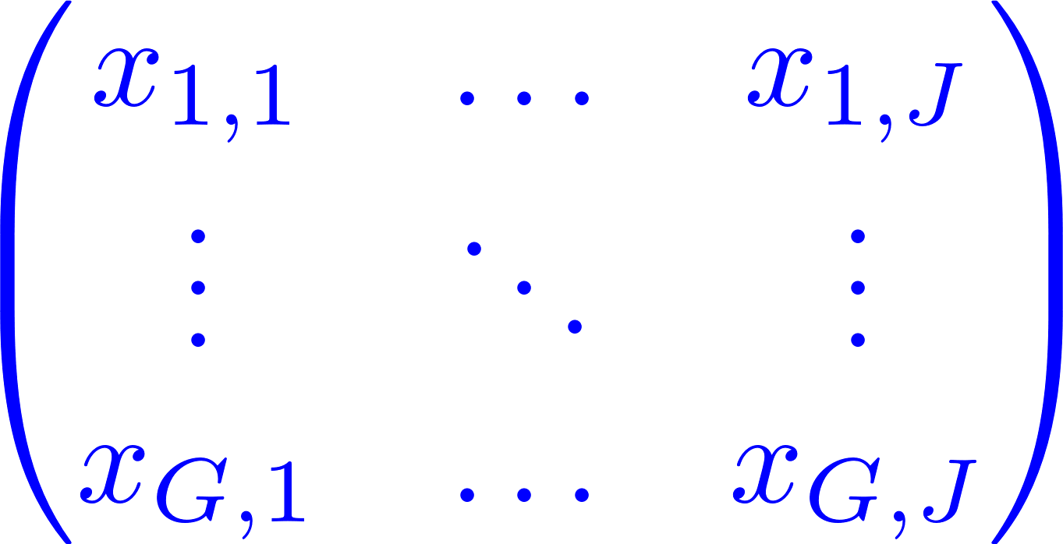


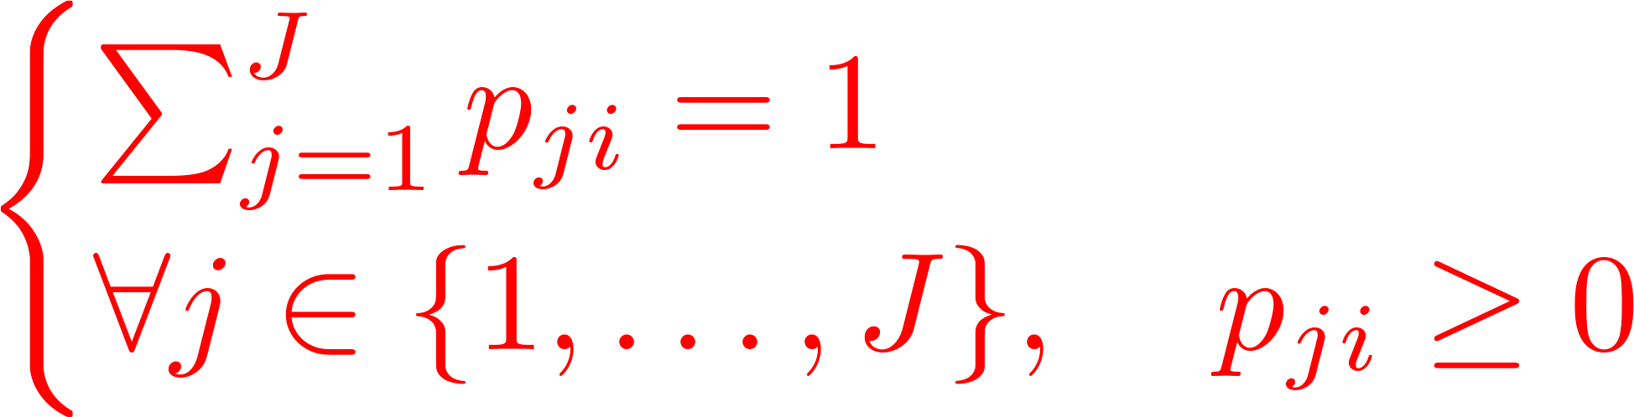


Standard deconvolution
Bulk profile
Purified cellular profiles
CD3
CD19
MHC-II
CD3
MHC-II
CD19
CD3
T cell pathway
CD19
MHC-II
Cell type proportions
CD3
B cell pathway
CD19
MHC-II
T cells
B cells
Macrophages
Macrophage pathway

